Slide 1

Analysis of AMEX travelling partners by region

Slide 2
Content
1. Why should AMEX focus on tourism market to improve its competitive edge
2. Global Tourism Market and breakdown by regions
3. Case study of Macau (Asian market)
4. Case study of Hong Kong (Asian market)
5. Domestic market

Slide 3
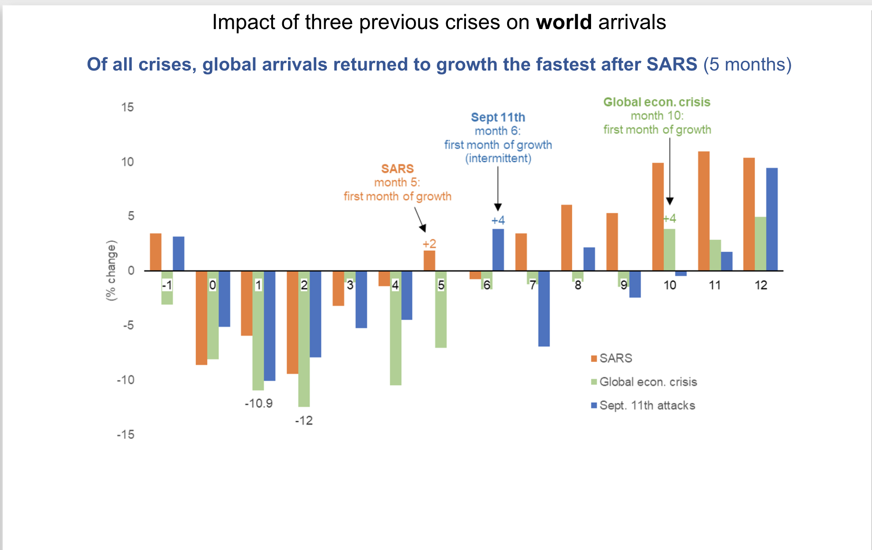
Why should AMEX focus on the tourism industry
Based on previous crises such as SARS, 2008 Global financial crisis and the 911 incident, tourism is one of the most affected industries and shows a strong resilience for recovery. AMEX can cooperate with airlines & the hospitality industry to revitalize the world tourism economics and boost business activities, which help it increases market share compared to other card issuers such as Discover, Visa, and Mastercard

Slide 4
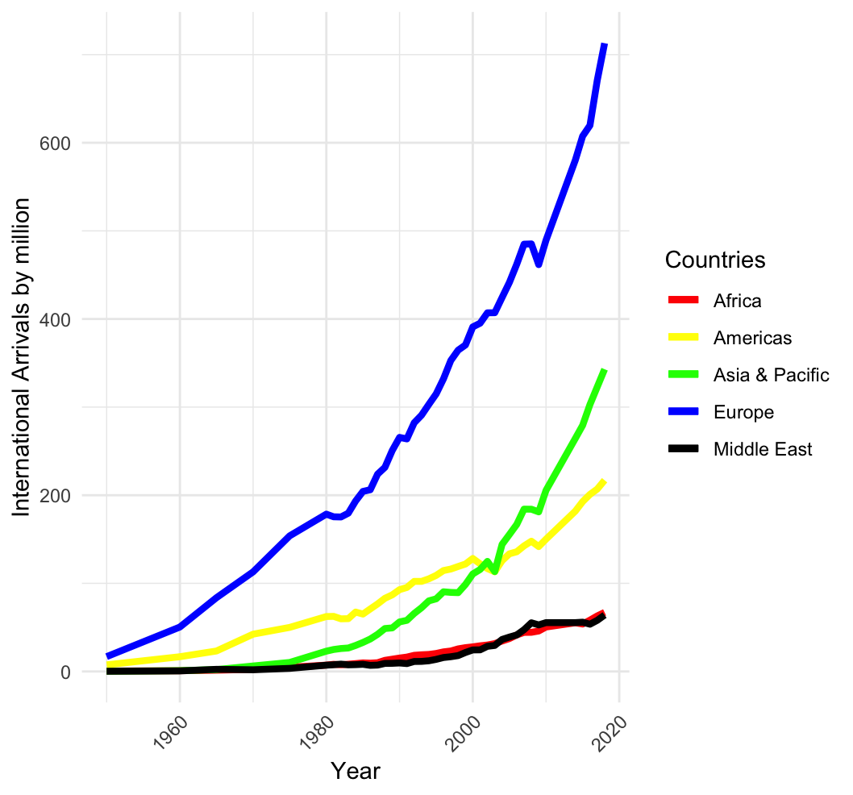
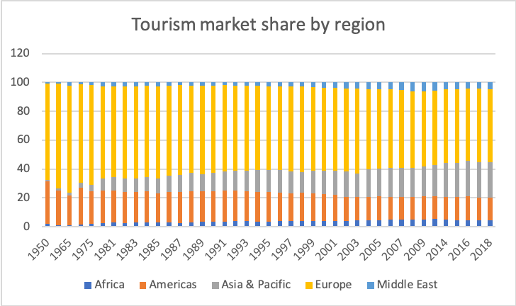
World tourism by 2018 (historic review)
According to historic tourism data by 2018, Europe was always the main travelling destination, taking up to half of the total market share since 1950. European tourism market also shows strong resilience after COVID-19 pandemic , for instance the rapid recovery of Italy. AMEX can be in close cooperation with major European airlines & hospitalities to offer better deals and therefore boost business opportunities.

Slide 5
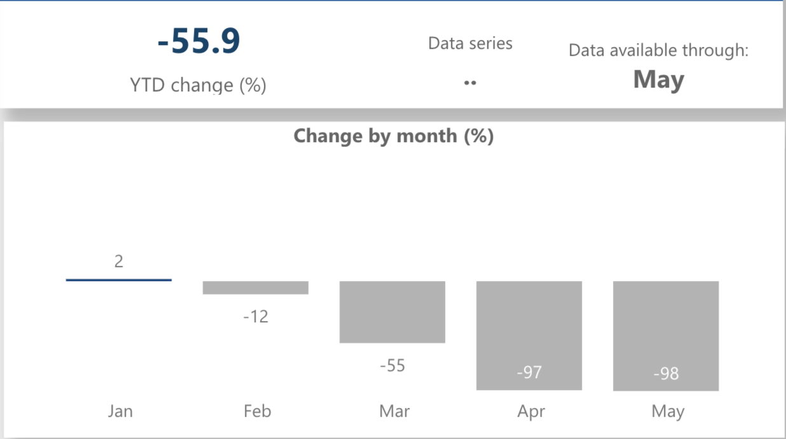
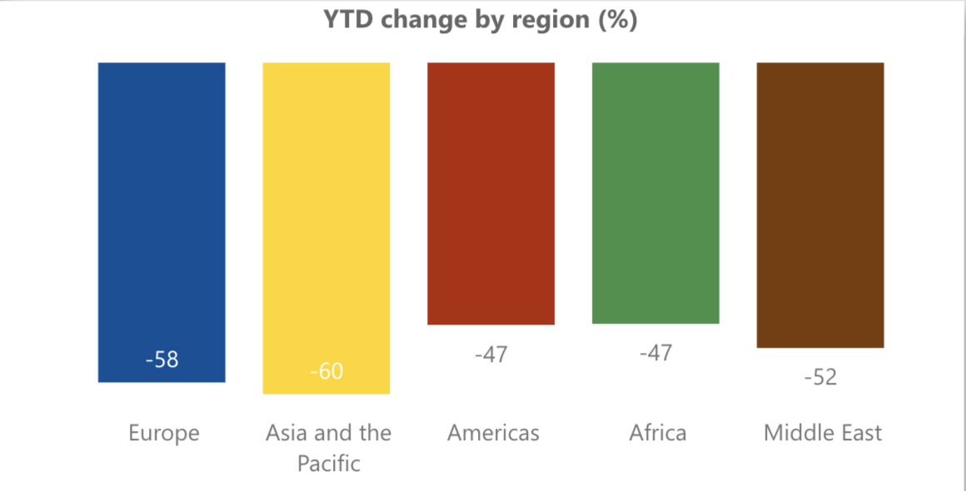
Covid-19 impact on Global Tourism Market
European and Asia & Pacific markets are two of the most affected markets in the global industry. By May 2020, the world tourism market has come to its unprecedented trough and showed huge potentials of bouncing back. AMEX is encouraged to catch this opportunity and dominate market share.

Slide 6
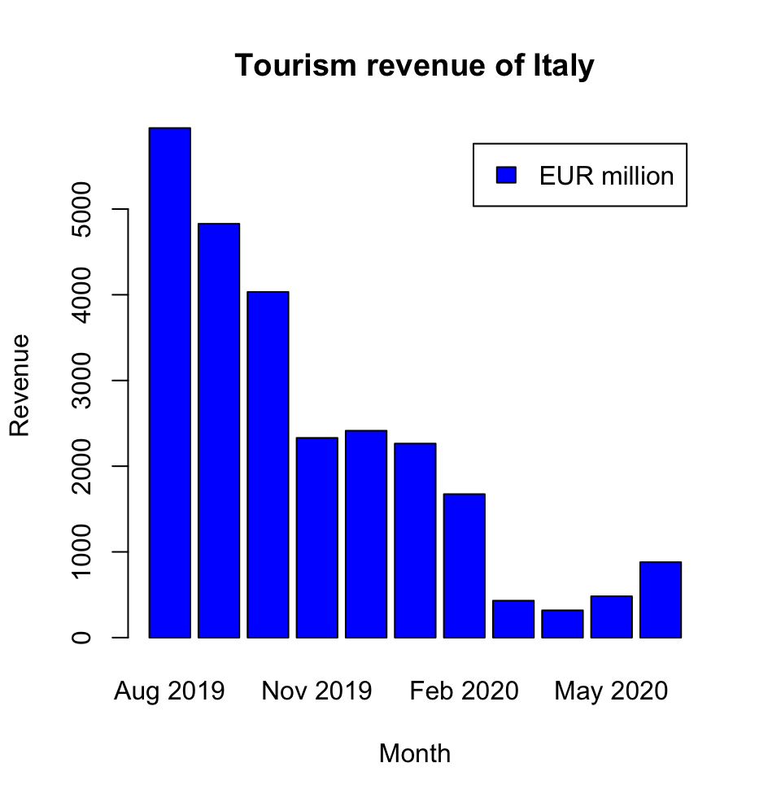
Example: Tourism industry in Europe
Italy has suffered severely from the outbreak of Covid-19 with a slump of international travelers since Feb 2020. Its tourism industry gradually recovered after May 2020 and has great potentials

Slide 7
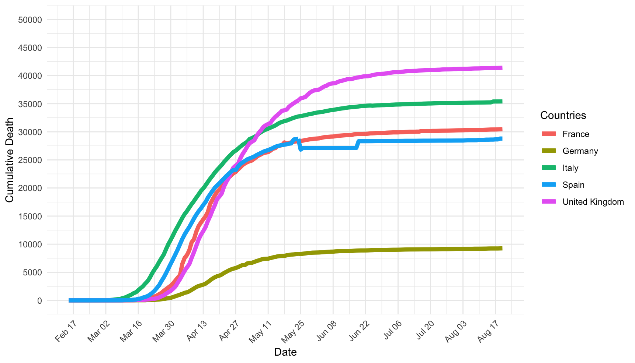
Covid-19 cases in European big five travel destinations
The five countries represent the key countries depending on the tourism industry in Western Europe
Despite different starting point, they all show sign of flatness since May with fewer daily new deaths due to Coronavirus

Slide 8
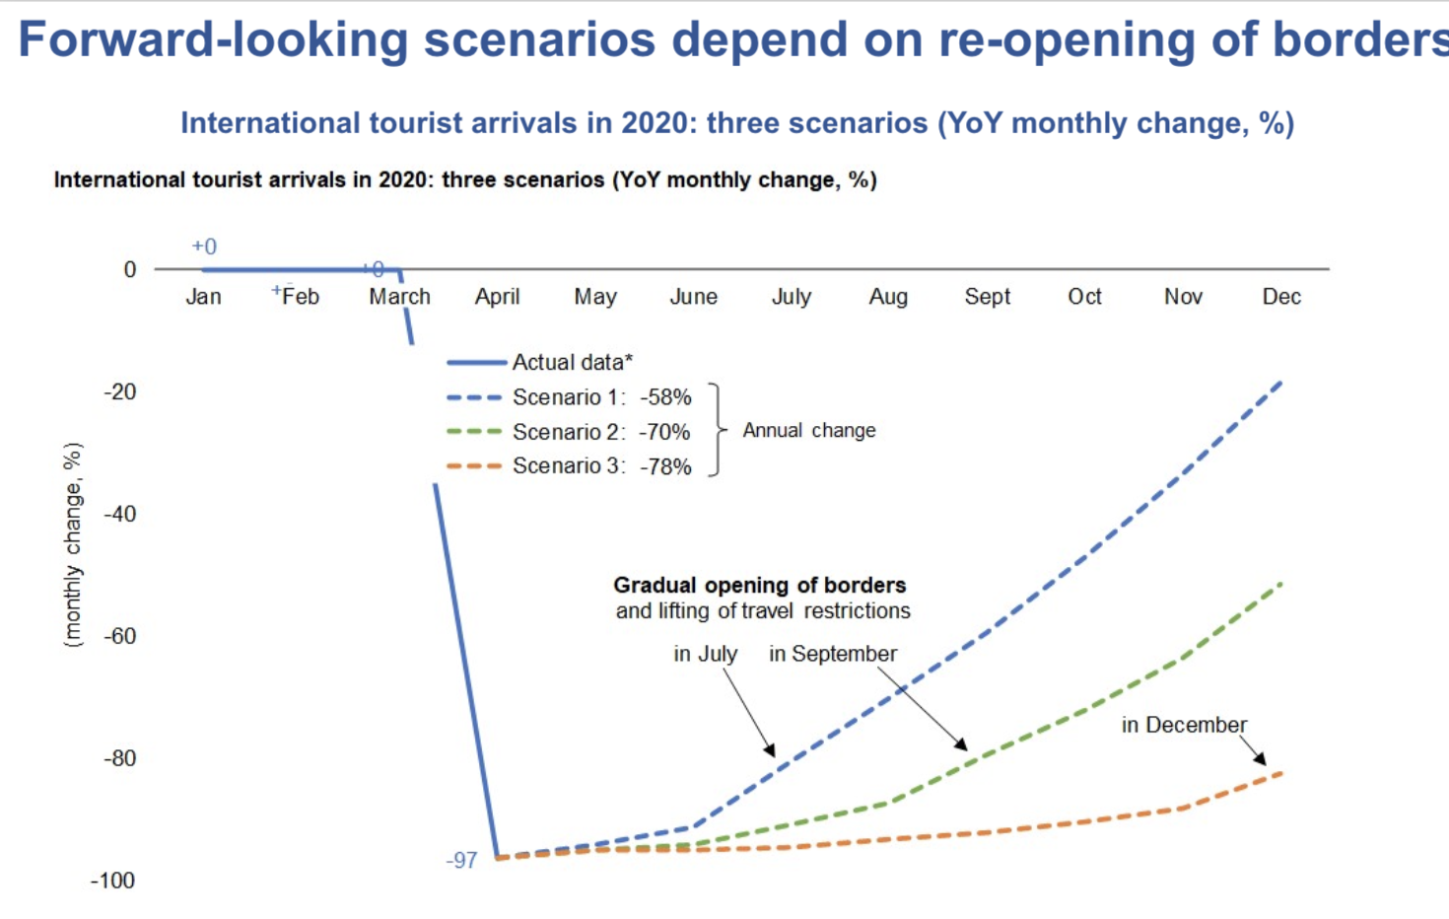
Forecasting of tourism industry in a foreseeable future
Three scenarios of world’s tourism industry are simulated
The tourism market is predicted to embrace a regrowth despite different speed and unpredictable waves

Slide 9
General Summary
The world tourism market has been severely slashed in the first half of 2020, among which Europe and Asia& Pacific market suffered substantial loss. Tourism market is expected to regrow since late 2020 and two major markets that AMEX might invest in are Asia & Pacifc and Europe, both for their dominant market shares and strong resilience by historic records.

Slide 10
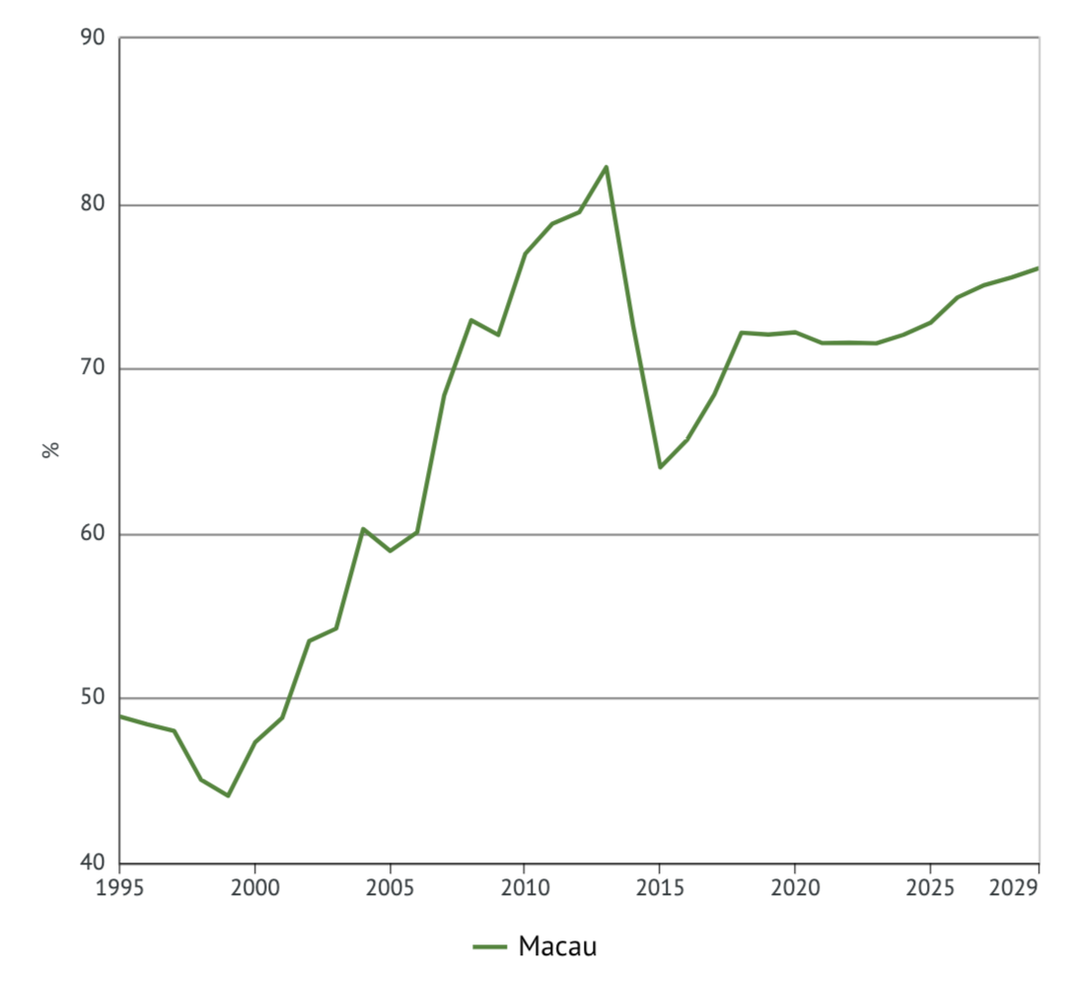
Case study of Macau & Hong Kong as a representation of Asian market
Macau, or “Las Vegas of Asia”, relies heavily on Tourism as one of its supporting business
Hong Kong tourism market has declined since 2019 affected by the dual effect of protests and Covid-19. Nevertheless, its tourism market remains a strong vibrancy
Tourism as % in Macau total GDP and forcast

Slide 11
Macao tourism performance of Macau 2019 vs 2020 Jan-July
Macau major tourism industry information
year | 2019 | 2020 | change(%)
GDP(million USD) | 54,333.80 | 11,283.40 | -79.233185
visitor arrival | 39,406,181 | 3,342,906 | -91.516798
average room price(USD) | 170.1 | 118.3 | -30.452675
Hospitality occupancy rate(%) | 90.8 | 25 | -72.46696
Total Visitor Expenditure(million USD) | 39975.75 | 4401.38 | -88.989875
Both hospitality industry and airlines industry have slashed during the first half of 2020
Source: https://dataplus.macaotourism.gov.mo/document/CHT/Report/GlobalIndicators/2020/1.%20Global%20Indicators%20%202020%20July.pdf

Slide 12
Recovery plan of Macau tourism industry in cooperation with AMEX
According to UNWTO, vouchers for cancelled travels as a reimbursement is encouraged
AMEX might be in direct contact with Macau local hotels and bring up discounted deals e.g. cheaper hotel, savings on food, provided spent on AMEX card
AMEX might cooperate with airlines companies that operate on Macau and provide discount if passengers purchase airline tickets between a certain period, e.g. Sep 1st ,2020 –Sep1st ,2021

Slide 13
Current AMEX offer in Macau statistics
Major Hotel & Restaurant deals
Hotel/Restaurants names | Discount on food & beverage(%) | Valid date until | Category
LOTUS LOUNGE @ GRAND LISBOA | 10 | 30/12/2020 | Restaurant
YUM CHA CHINESE RESTAURANT | 15 | 31/12/2020 | Restaurant
FRASCATI CAFÉ | 20 | 31/03/2021 | Restaurant
OSKAR’S BAR | 20 | 31/03/2021 | Restaurant
PORTAS DO SOL | 10 | 30/12/2020 | Restaurant
GRANDVIEW HOTEL MACAU | up to 70 | 31/12/2020 | Hotel
GRAND EMPEROR HOTEL | package offer | 31/12/2020 | Hotel
HOTEL ROYAL | package offer | 31/12/2020 | Hotel

Slide 14
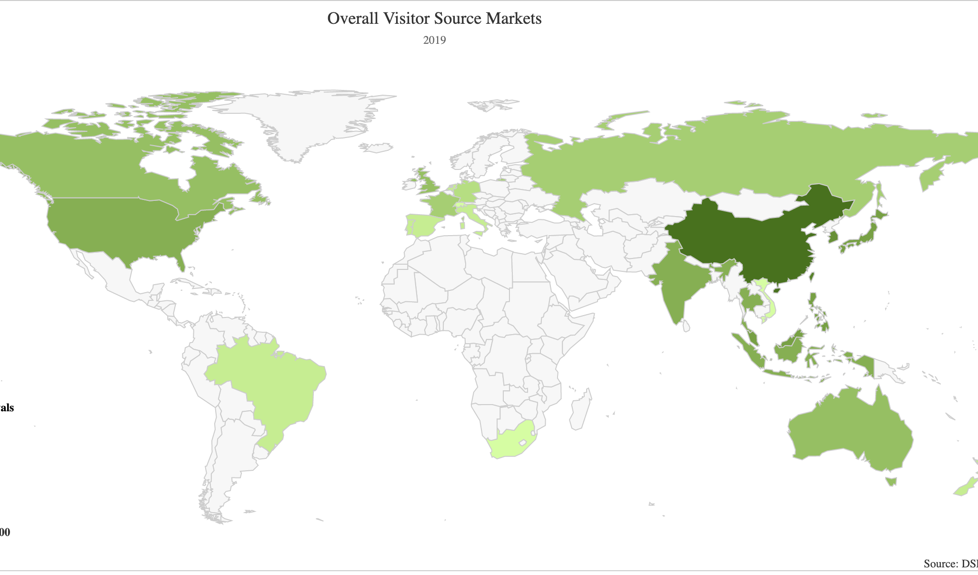
Macau visitors source market map
Expect for mainland China, major visitors source include North America and SouthEast Asia & Pacific
AMEX might focus on deals with tourists from the above markets
Source: dsec

Slide 15
Further advices based on current AMEX deals in Macau
Macau tourism market include airlines market, hospitality, Casino industry and Restaurants
Offers incorporating discount on local airlines, hotels and casino as a whole travelling packages are encouraged in order to attract tourists
AMEX might target source market in southeast Asia & Pacific and North America
AMEX might advertise more on popular travelling platform e.g. Lonely Planet to improve its potential customers, and conduct A/B test to measure the performance of these methods

Slide 16
Hong kong tourism facts
Tourism contributes to 4.5% of Hong Kong GDP in 2018 and it has largely slash compared to 2019

Slide 17
Hong Kong main source market

Slide 18

Further Advice based on Hong Kong source market
Hong Kong is one of the most attractive tourist destination in Asian market and its main customers come from China and other parts of Asia
AMEX might cooperate with Hong Kong airline companies such as Cathay Pacific to come up with discount that include return tickets and create travel portfolio incorporating local hotels and airlines
AMEX might develop diversified travelling package such as cruise, partnership with luxury store, cultural excursion

Slide 19
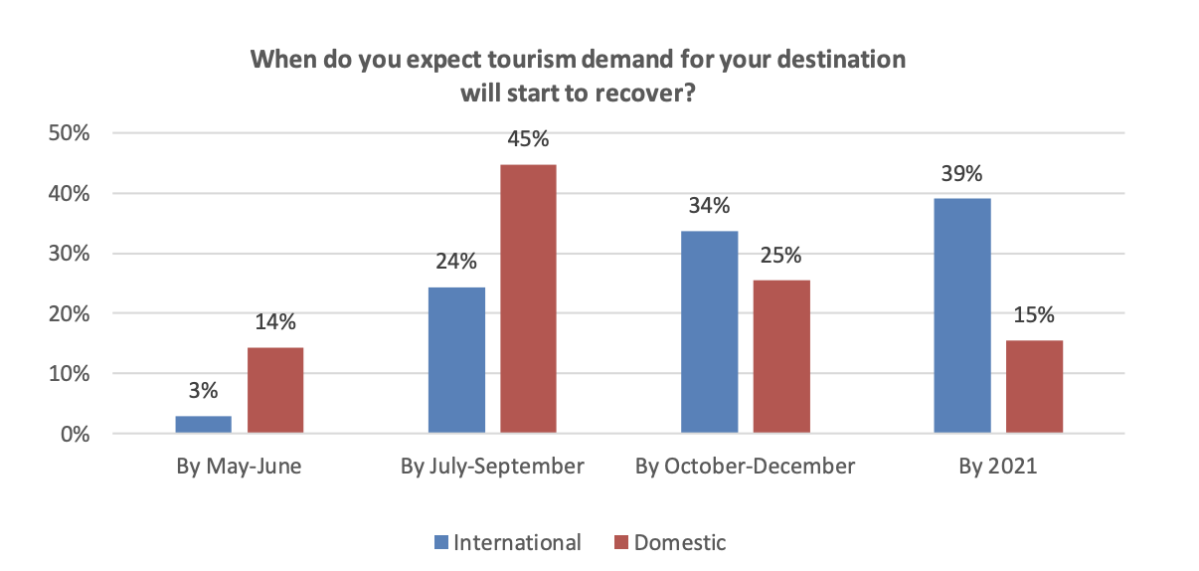
Domestic tourism market
Domestic demand expected to recover faster than international demand
Therefore AMEX should focus on offering adverts towards domestic destinations based on the customers current location.
In the mid-to-long term, when border restrictions are gradually lifted, AMEX should promote more mid or long haul destinations, they should tailor to individual regions to better suit their needs. Empirical data from previous crises are especially important to give insights on intercontinental travel.

Slide 20
Major airlines partner with AMEX and the approximate value per earning point
Airlines | Approximate value per point | Region
American Airlines AAdvantage | 1.2p | US
Alaska Mileage Plan | 1.4p | US
United MileagePlus | 1.0p | US
Delta SkyMiles | 0.9p | EU
British Airways Avios | 1.1p | EU
British Airways On Business Points | 3.3p | EU
Virgin Atlantic Flying Club | 1.3p | EU
Flying Blue (Air France/KLM) | 1.0p | EU
Emirates Skywards | 0.9p | ME
Etihad Guest | 1.1p | ME
Qantas Points | 0.8p | ME
Qatar Qmiles | 0.6p | ME
Singapore KrisFlyer | 1.2p | AS
Amex might improve the converting ratio of each pointed earn as a stimulus to improve its regional market
On average, EU market is by far the most profitable

